Slide 1
Michael Allen Sprint #5 Review
Exploratory & Analysis of
US Contagious Diseases

Slide 2
Game Plan
1. Read into R a CSV file Containing US Contagious Diseases
2. Use R to Perform Initial Exploratory Analysis
3. Learn How to Utilize the Filter within R Studio to Assist in the Analysis
4. Write a Script to Calculate the Disease per State by the Highest Percentage Sick
5. Write the Analysis Data back to a CSV file

Slide 3
Create a Script in R to Perform Statistical Analysis

Slide 4



Viewing the Highest Sick Percentage after Calculation

Slide 5



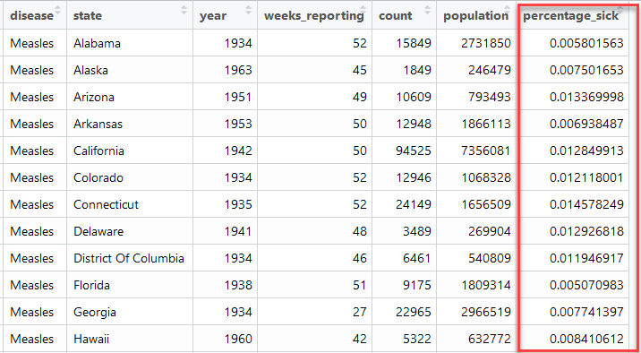
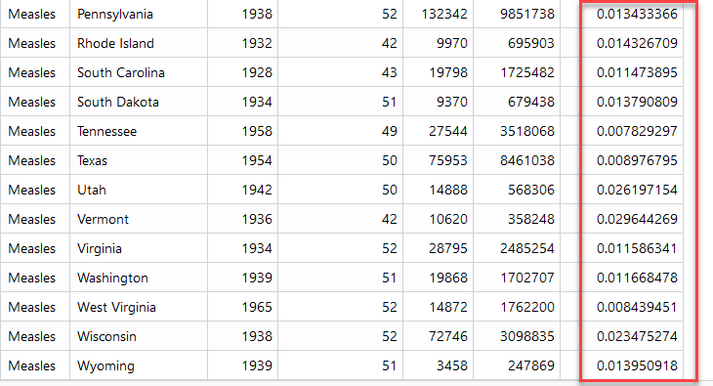
Calculating Each State’s Highest Percentage of Being Sick

Slide 6


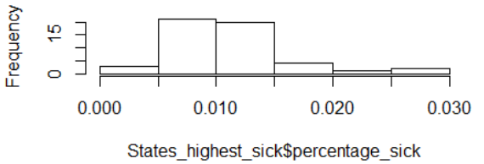
Calculating the Mean for All States for the Highest Percentage Sick
And Histogram

Slide 7
Calculating the Mean for the Highest Percentage Sick
And Histogram

Slide 8


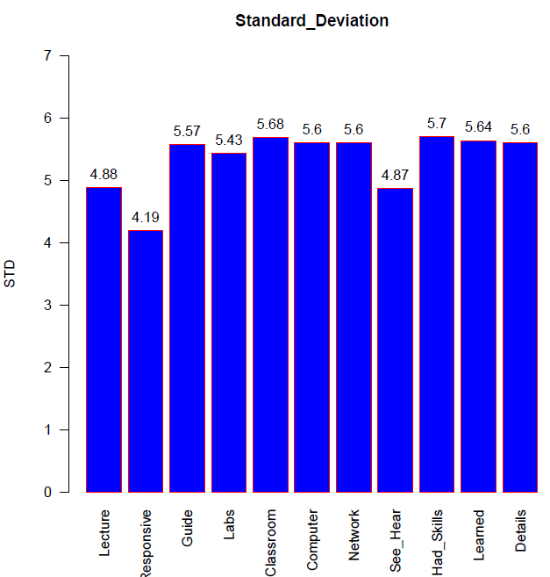
Parameters of the Standard Deviation Graph

Slide 9
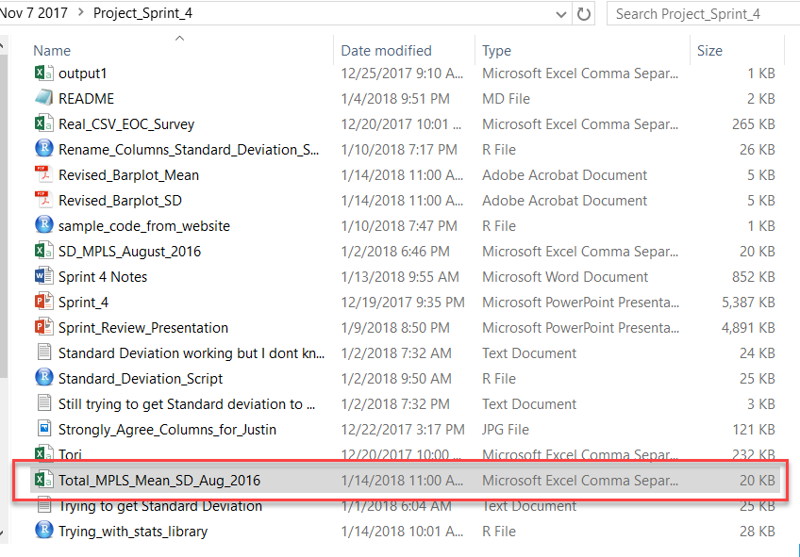

Write the R Completed Analysis Data Back to a CSV File
write.csv(Total_MPLS_Mean_SD_Aug_2016, "Total_MPLS_Mean_SD_Aug_2016.csv")

Slide 10
Thank you

